Slide 1
SA
Hibernate in Java
Hibernate is a Java framework that simplifies the development of Java application to interact with the database.
Presented by :
Pranjal Bagul (MC22F14F006)
Vaishnavi Baraskar (MC22F14F007)

Slide 2

What Is Hibernate?
1
Object relational mapping
2
Open-source framework
Hibernate is free and open-source, with a large and active community of developers working to improve and extend it.
Hibernate is a powerful Java library that maps Java objects to relational database tables. It frees developers from the burden of writing boilerplate SQL code.
3
Widely used
Hibernate is widely used in industry and is supported and used by major Java frameworks like Spring and Struts.

Slide 3
Benefits of Using Hibernate
Saves Time
Maintainable Code
Reduced Database Load
By abstracting away the details of JDBC, Hibernate allows developers to write less code and get the job done faster.
With Hibernate, complex data operations become easy, resulting in cleaner and maintainable code.
Hibernate uses caching mechanisms to reduce the number of queries that hit the database, resulting in better performance and scalability.

Slide 4
Getting Started with Hibernate
1
Configure Hibernate Properties
Connect to your database by specifying the database connection properties in your Hibernate configuration file.
Set Up Hibernate in Java
2
Add the necessary Hibernate library files and create a session factory to start working with Hibernate.
3
Mapping Java Classes to Database Tables
Create the necessary table mappings to ensure that your Java objects are correctly stored in the database.

Slide 5
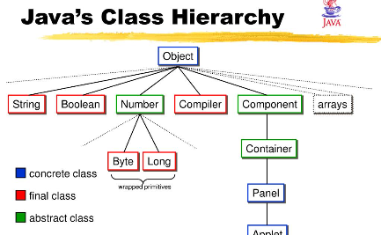
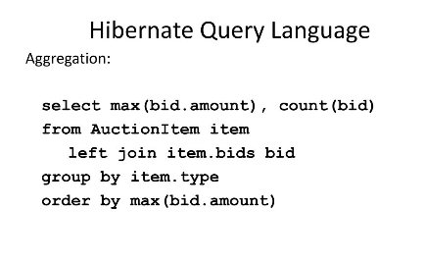
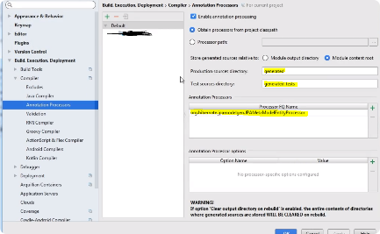
Working with Hibernate
Mapping Java Classes to Database Tables
Hibernate Query Language (HQL)
Hibernate Criteria API
Use the Hibernate Criteria API to construct database queries programmatically in a type-safe way.
Use annotations or XML configuration files to map Java classes to database tables, making data access easier for developers.
Write advanced database queries using HQL, a powerful object-oriented query language for Hibernate.

Slide 6
Advanced Hibernate Concepts
Second-Level Caching
Batch Processing
Transactions
Increase performance by implementing second-level caching in Hibernate. It reduces the number of queries sent to the database, improving application performance.
Collate objects and database operations together into a single batch to minimize database overhead, reducing transaction and query costs.
Understand the concept of database transactions and the mechanisms Hibernate offers to ensure data integrity and consistency during transactional operations.

Slide 7
Integration of Hibernate with other Frameworks
1
Hibernate with Spring
Spring is a popular framework that simplifies the development of enterprise Java applications. Integrate Hibernate with Spring to handle database operations with ease.
Hibernate with JDBC
2
JDBC is the standard API for working with databases in Java. Integrate Hibernate with JDBC to leverage existing database components and tools.

Slide 8
Key Components of Hibernate Framework
SessionFactory
Session
It's a factory of session that opens up a connection to the database and allows the application to perform database operations.
It's a lightweight object that represents a single connection or a conversation between the application and a database.
Transaction
Query
It's an atomic unit of work that is performed on the database. It ensures data consistency by committing or rolling back transactions.
It is a Hibernate Query Language (HQL) statement that retrieves or updates data in the database.

Slide 9

Similarities and Differences
1
Similarities
Both Hibernate and JDBC allow us to interact with databases and perform CRUD operations.
2
Differences
While JDBC is a low-level API that requires writing SQL queries, Hibernate abstracts the database access layer and provides an object-oriented approach.

Slide 10
JDBC vs Hibernate Performance
JDBC
Hibernate
Offers direct and efficient access to the database, making it faster for simple operations and batch updates.
Provides a level of abstraction that can add overhead, but offers features like caching and lazy-loading, improving performance in certain scenarios.

Slide 11
Hibernate's Advantages
Productivity
Portability
Object-Relational Mapping
Hibernate eliminates the need for manual SQL queries, reducing development time and effort.
With Hibernate, you can switch databases without changing the application code.
By mapping Java objects to database tables, Hibernate simplifies working with data.

Slide 12
Choosing Between JDBC and Hibernate
JDBC
Hibernate
When working on small projects
When dealing with complex database models
When the emphasis is on performance and control
When productivity and maintenance are priorities

Slide 13
Thank you!

